Slide 1

Aws Deployment on Regex Patterns
Done by
Preethi Sundar

Slide 2
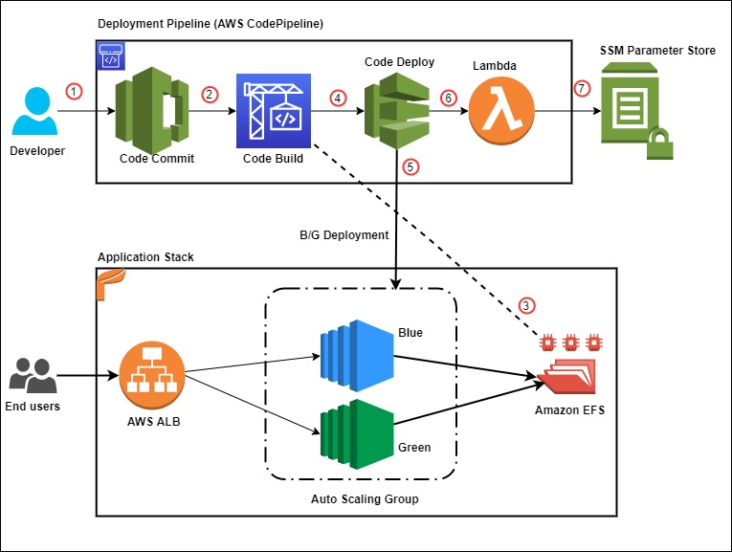

Slide 3
Overview
To replicate the core functionality of the website regex101.com. This entails creating a web application that allows users to input a test string and generate the regex_pattern and verify the Email Address

Slide 4
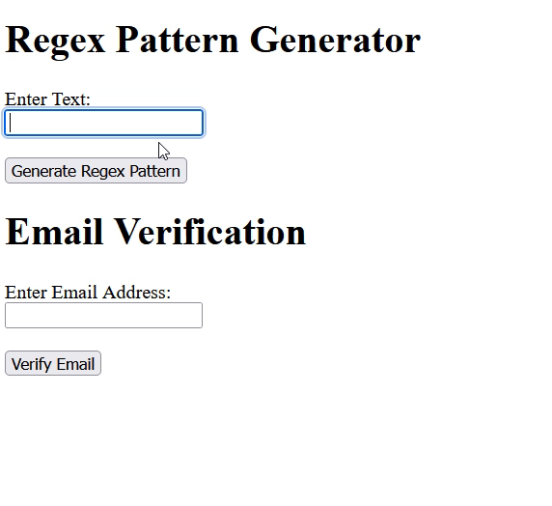
App on Regex Pattern

Slide 5


